Slide 1

MINOR PROJECT-1
Topic: Student Attendance System using QR Scan

Slide 2

Project Supervisor
Dr. Nileshkumar R. Patel
Faculty Member (CSE)
Notes:
Notes to presenter:
What is your purpose for sharing this reflection?
Is it at the end of a unit or project?
Are you sharing this reflection, at the attainment of a learning goal you set for yourself?
Is it at the end of a course?
State your purpose for the reflection or even the purpose of the learning experience or learning goal. Be clear and be specific in stating your purpose.

Slide 3

Presented by:
Ashutosh Srivastava 201B072
Pakhi Vashishth 201B171
Pampa Ghosh 201B173
Notes:
Notes to presenter:
Description of what you learned in your own words on one side.
Include information about the topic
Details about the topic will also be helpful here.
Tell the story of your learning experience. Just like a story there should always be a beginning, middle and an end.
On the other side, you can add a graphic that provides evidence of what you learned.
Feel free to use more than one slide to reflect upon your process. It also helps to add some video of your process.

Slide 4
CONTENT
OBJECTIVE
SYSTEM BASED ON
NEED OF PROJECT
STRUCTURE
WORKING
ER DIAGRAM
TOOLS AND TECHNOLOGIES
EXPECTED OUTCOME
ADVANTAGES
SYSTEM REUIREMENTS
REFERENCES

Slide 5
OBJECTIVE
The objective of this project is to ease the attendance marking system for both professors and students. The developed system will use QR codes to mark the attendance of students, which will reduce the attendance-taking time and will allow the professor to deliver more useful content in their lectures.

Slide 6


SYSTEM BASED ON
ANDROID APP
WEB PORTAL

Slide 7
NEED OF PROJECT?
In bigger lecture theaters like LT-5 or classes with 100+ students, marking attendance is a very time-consuming. Daily, almost 10-15 minutes are wasted in this process, so we got the idea of developing this system which will minimize the attendance-marking time by giving the data of scanned QR codes to the professor.

Slide 8
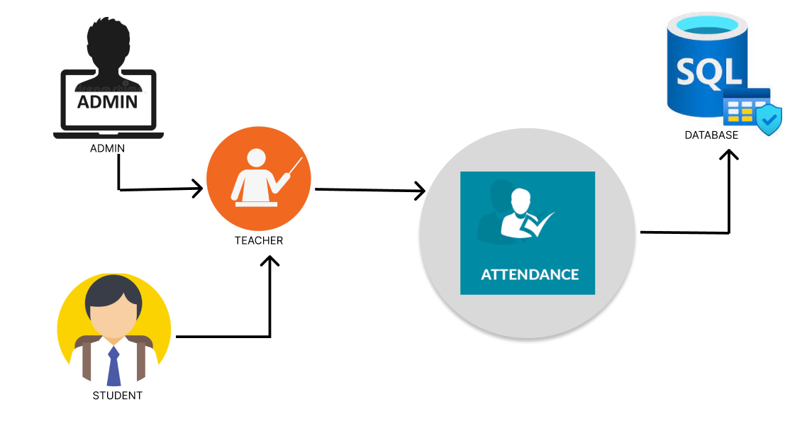
STRUCTURE
Admin Panel
Teacher’s Panel
Student’s Panel

Slide 9

ADMIN PORTAL
Admin panel is web based and will have a login portal
Admin can add departments, courses, and related information.
In admin panel, only the admin can add professors and assign courses to them.
Admin panel will approve the students registration and also update their information.
Admin will assign courses to the students.

Slide 10

TEACHER’S PANEL
In this panel, there will be a login for professor.
This is also a web portal
Professor can generate QR codes for their subjects here.

Slide 11

STUDENT’S PORTAL
This will be a mobile application
Students are required to login, and each login will have a unique ID.
Students will scan QR code with this app.
This app will mark present for only those students who are within the marked location.

Slide 12
WORKING
●The professor will generate the QR code on the website. While generating the QR, professors need to enter some data like timing of class, batches and lecture theater number.
● When the QR code is scanned on app, the app will check for all this data and if found any data not relevant or location not as per marked area, the attendance won’t be marked.
● If the app found all data to be true, then it will send the student’s data to the website.

Slide 13
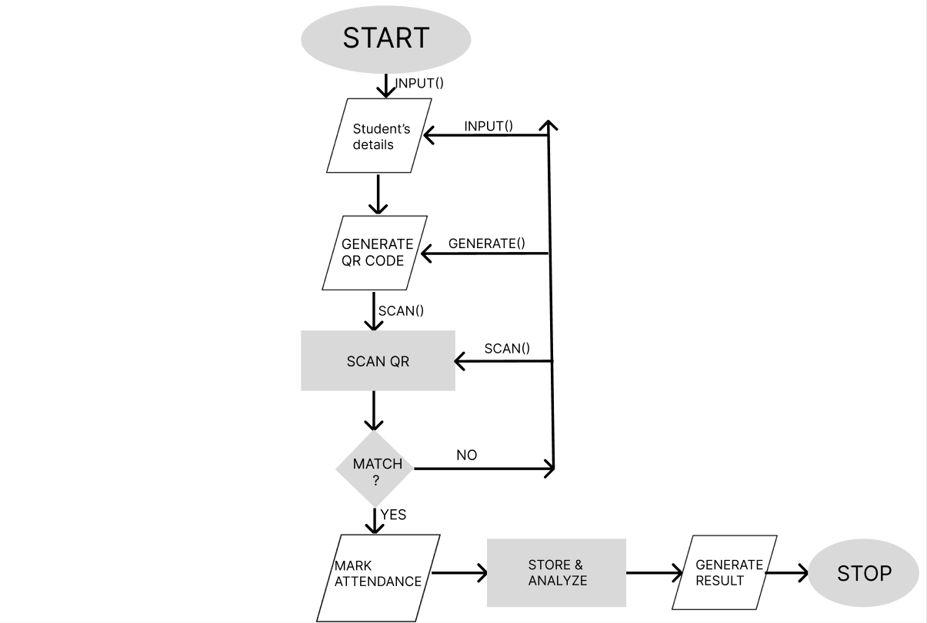
BLOCK DIAGRAM

Slide 14
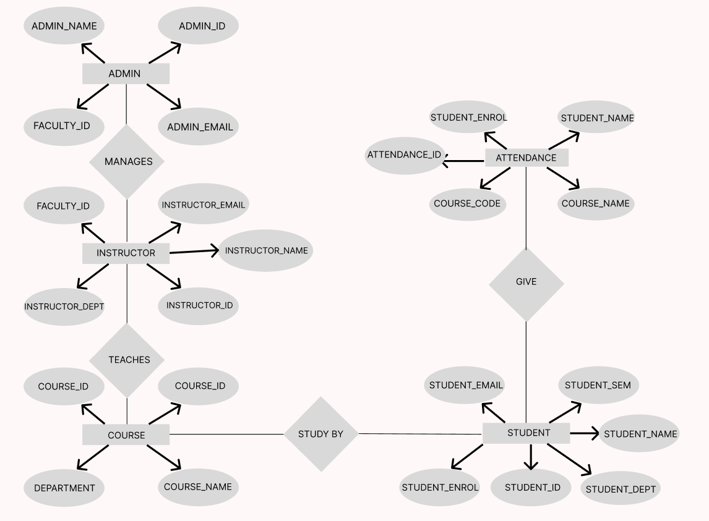
ER DIAGRAM

Slide 15



TOOLS AND TECHNOLOGIES USED
Flutter - Dart
HTML, CSS , JAVASCRIPT
PHP, MYSQL
FIREBASE

Slide 16
ADVANTAGES
Saves Time
2. Prevents proxies
3. No paper work
4. More efficient

Slide 17
SYSTEM REQUIREMENTS
HARDWARE SPECIFICATIONS
SOFTWARE SPECIFICATIONS

Slide 18

EXPECTED OUTCOMES AFTER END SEM
4
3
2
1
Notes:
Notes to presenter:
What steps will you be taking as a result of this learning experience?
Did you learn from any failed experiences? How will you do things differently?
What advice will you give to others so they can learn from your experiences?
How can you share what you learned with a real-world audience?
Some examples of next steps might be:
After delivering my first persuasive presentation, I am thinking about joining the debate team.
After making my first film, I’m considering entering it in our school film festival or local film festival.
After connecting with this career expert, I’d like to do some research on that career field because it sounds interesting to me.
This SmartArt allows you add images and text to help outline your process. If a picture is worth a thousand words, then pictures and words should help you communicate this reflection on learning perfectly! You can always click on Insert>SmartArt to change this graphic or select the graphic and click on the Design contextual menu to change the colors.
Feel free to use more than one slide to share your next steps. It also helps to add some video content to explain your message.

Slide 19
REFERENCES
2nd International Conference on Advances in Science & Technology (ICAST) 2019 on 8th, 9th April 2019 by K J Somaiya Institute of Engineering & Information Technology, Mumbai, India
2. Zaid
Benefits of using tested attendance system to enhance student attendancePosted: 2012-05.
https://www.academia.edu/26761124/Enhancing_Higher_Education_Student_Attendance_through_Classroom_Management
3. D Deugo
Using QR-Codes for Attendance Tracking
Int'l Conf. Frontiers in Education: CS and CE FECS’15
http://worldcomp-proceedings.com/proc/p2015/FEC2508.pdf
4. Attendance & Session Tracking. WebPosted: 2015-05-15
https://ieeexplore.ieee.org/document/7218103
5. Smartphone Users Around the World -Statistics and Facts, volume 12Posted: 2014
https://www.isrctn.com/ISRCTN15315334

Slide 20
THANKYOU

